Slide 1
Long-Mann 16-Bit RISC Processor
Final DESIGN REVIEW presentation
Taylor Long, Jared Mann

Slide 2
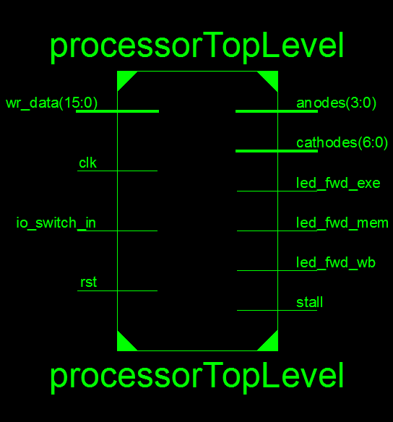
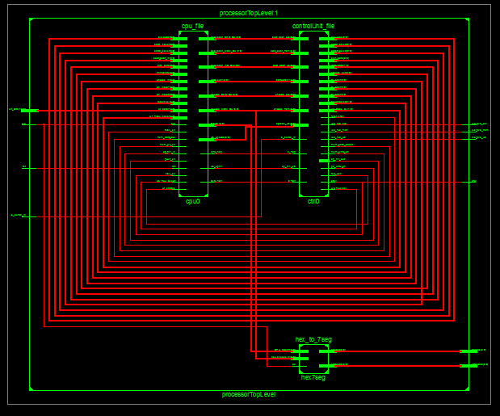
High Level Overview
Hierarchy and RTL SCHEMATIC

Slide 3
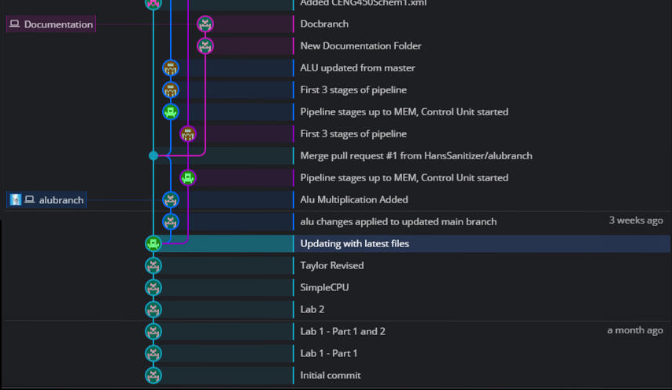
Development Timeline – Note (will remove later): These times in reference to 9pm 3/26/2017
FIRST STEPS – SIMPLE CPU, ALU, STARTING CONTROL UNIT AND PIPELINE STAGES

Slide 4
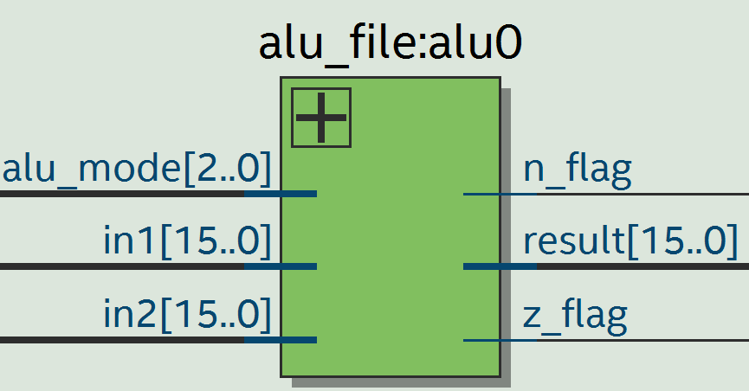
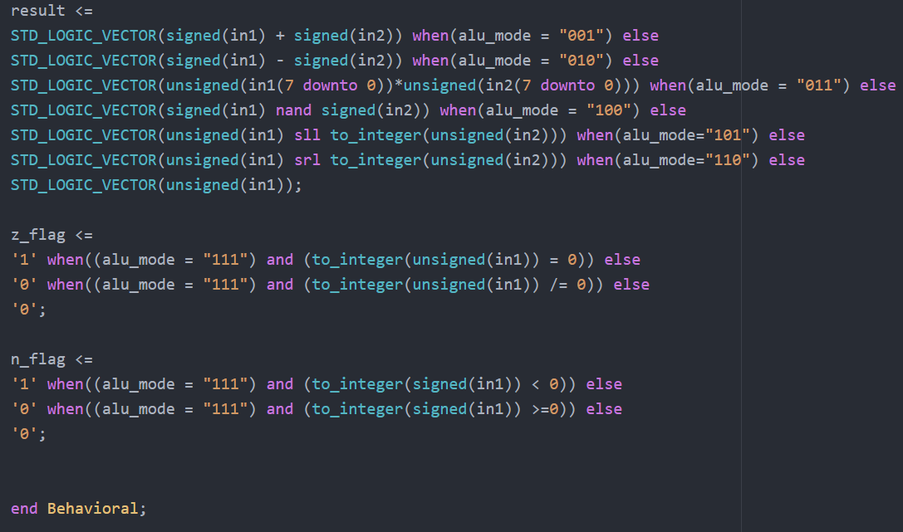
THE FINISHED ALU
Performs in all required modes.
Multiplication is product of 8bit by 8 bit multiplication

Slide 5
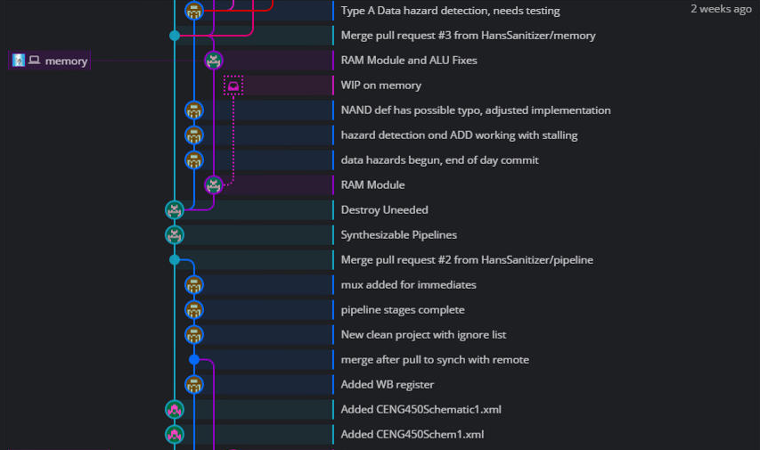
Development Timeline
FINISHING PIPELINE STAGES, RAM MODULE, BEGINNING HAZARDS

Slide 6
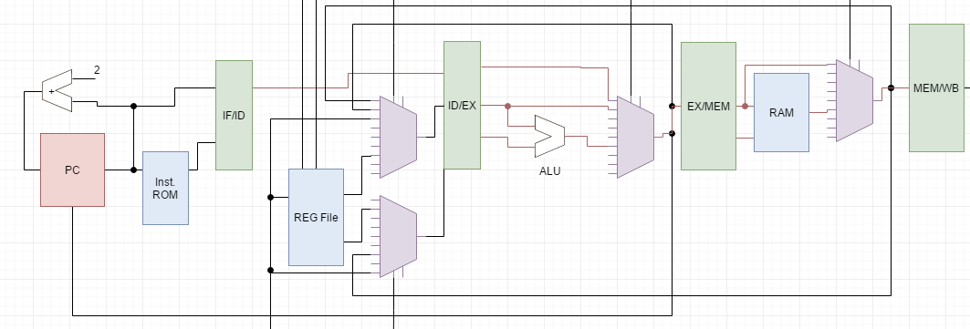
Pipeline Stages
ID/EXE
EXE/MEM
MEM/WB
IF/ID

Slide 7
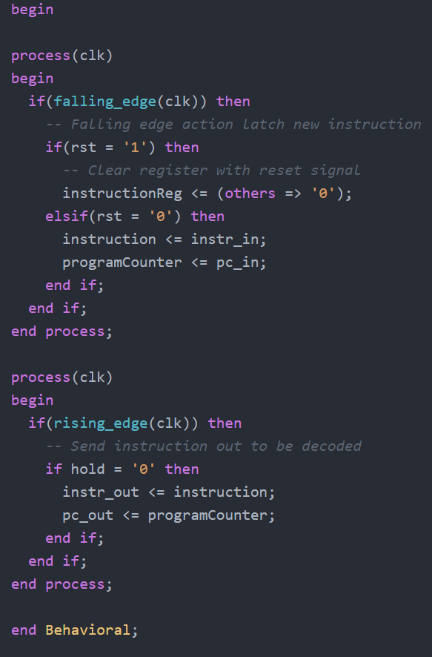
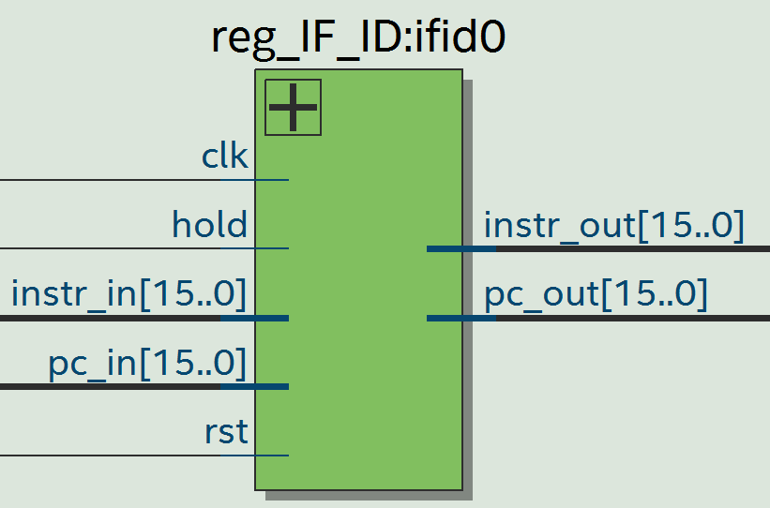
Pipeline Stages – Instruction Fetch / Instruction Decode

Slide 8
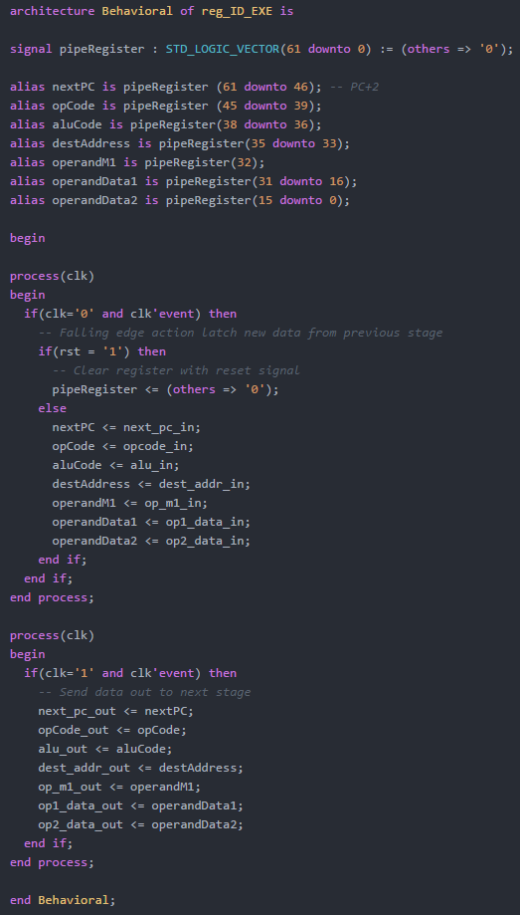
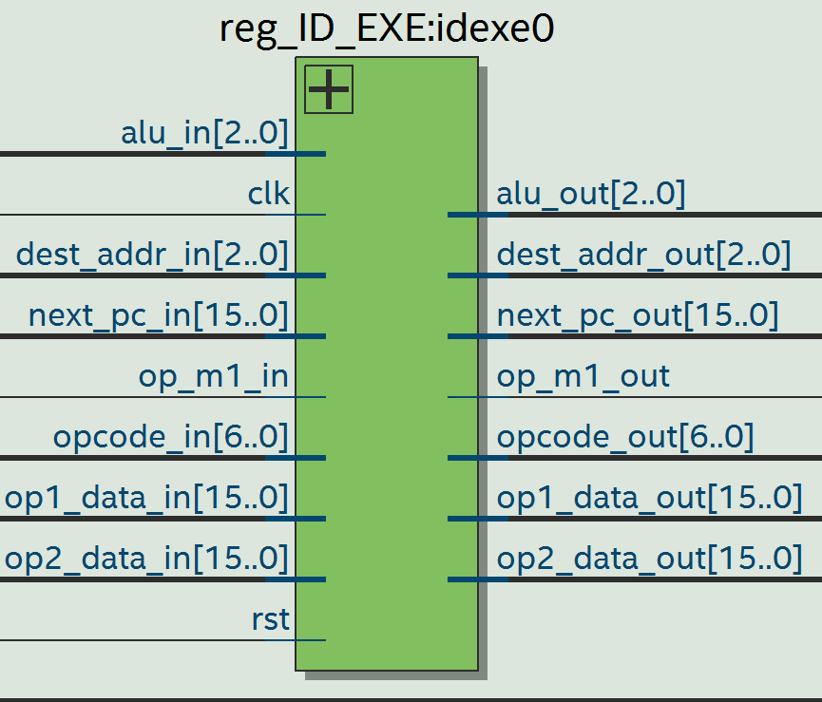
Pipeline Stages – Instruction DECODE / EXECUTION

Slide 9
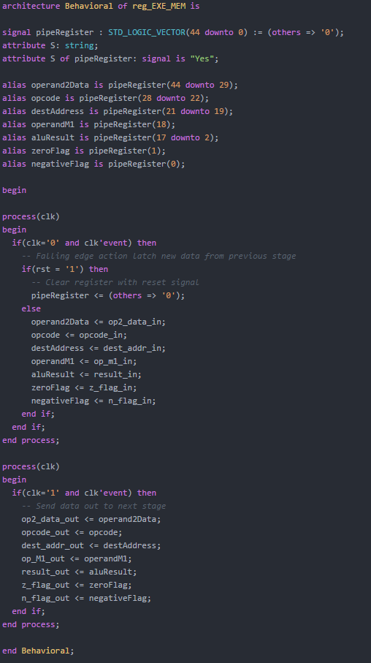
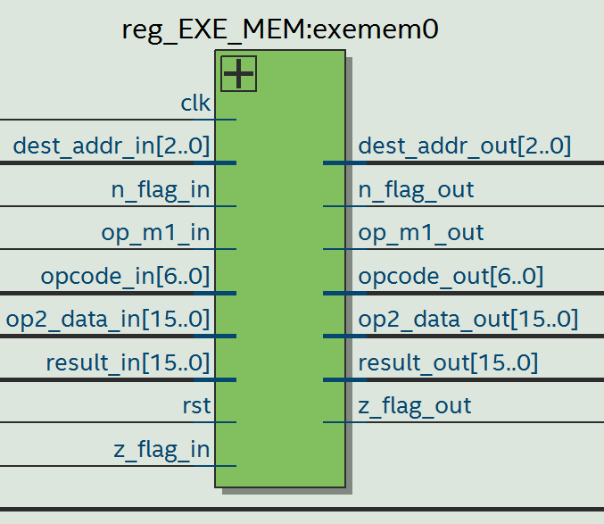
Pipeline Stages – EXECUTION / MEMORY

Slide 10
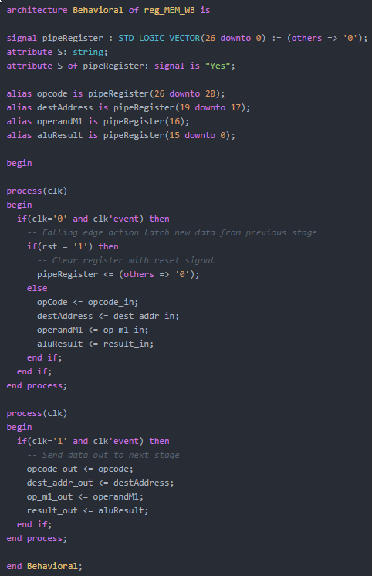
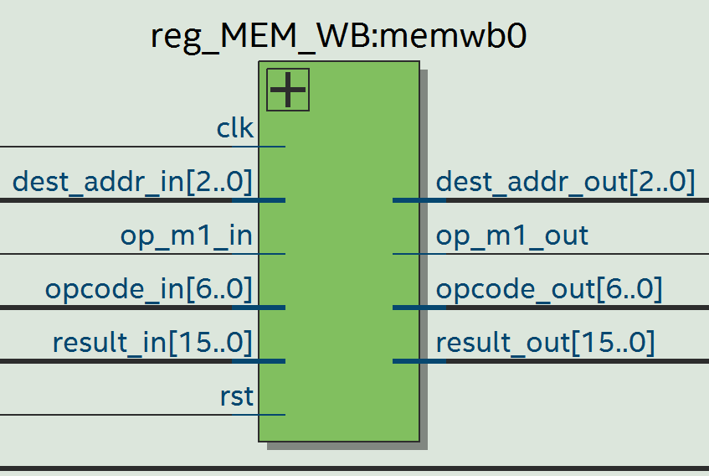
Pipeline Stages – Memory / Writeback

Slide 11
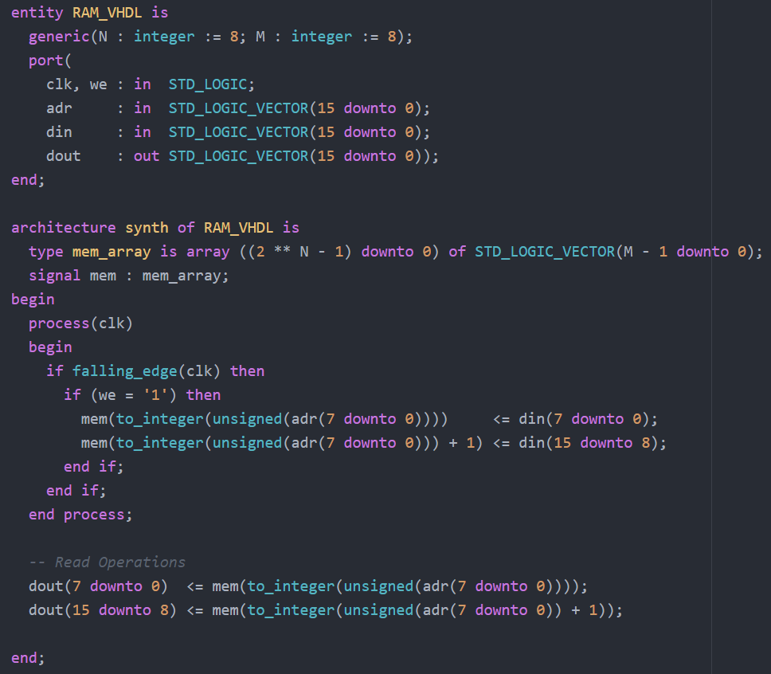
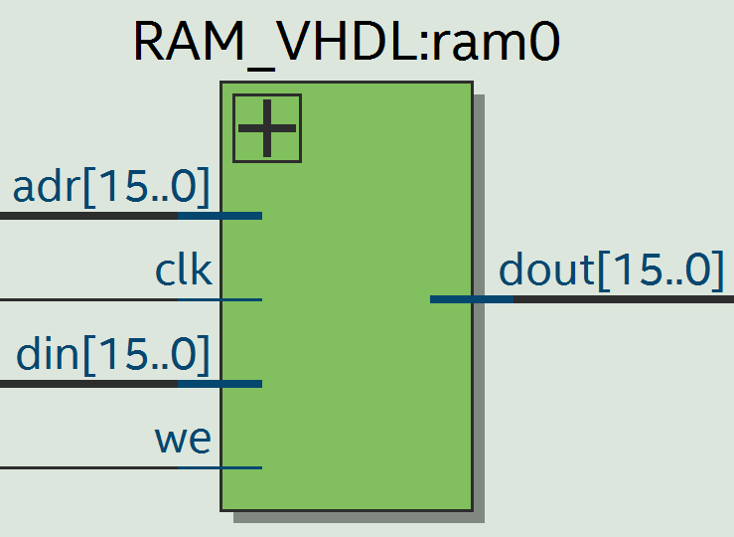
RAM MODULE

Slide 12
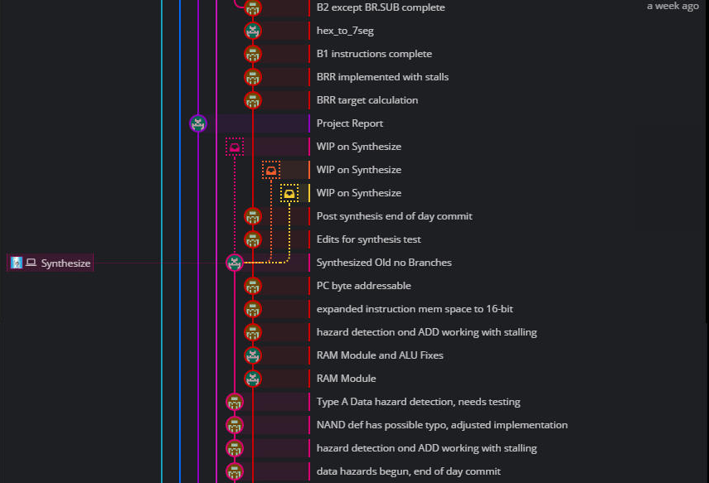
Development Timeline
FINISHING HAZARD DETECTION, STARTING BRANCH INSTRUCTIONS, STARTING USER I/O

Slide 13
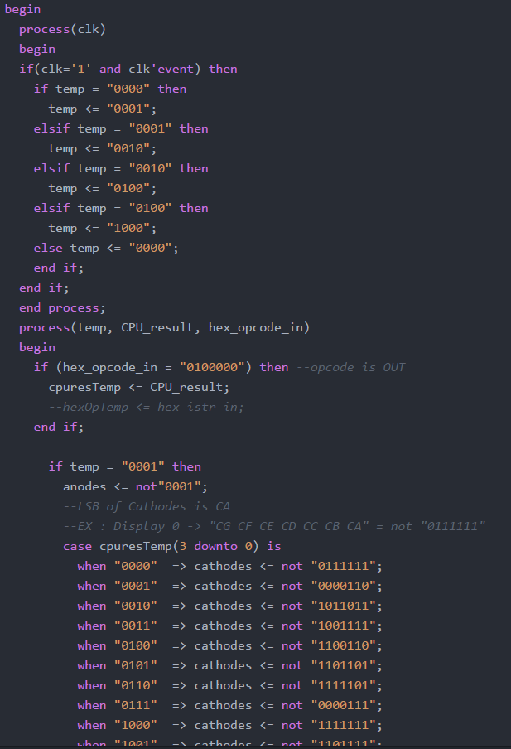
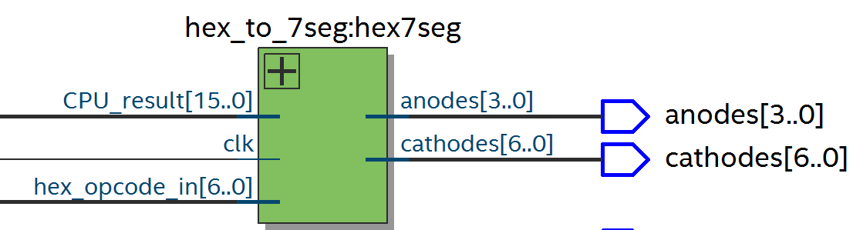
Hex to Seven Segment Display Driver

Slide 14
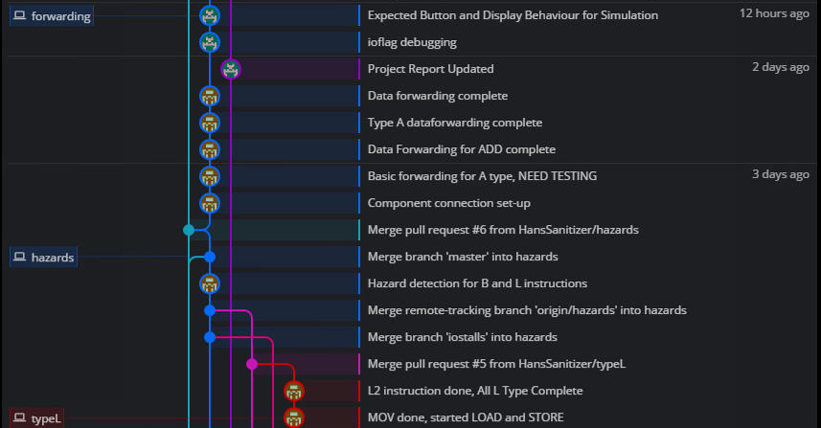
Development Timeline
FINISHING L INSTRUCTIONS, USER I/O DEBUGGING, DATA FORWARDING

Slide 15
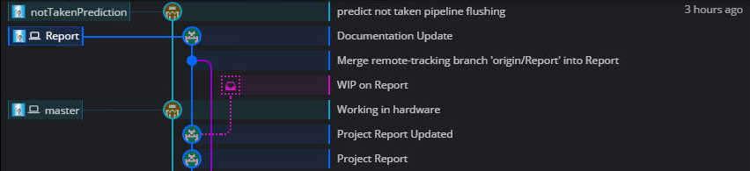
Development Timeline
FINAL TOUCHES – BRANCH PREDICTIONS, PROJECT REPORT WRITING

Slide 16
Looking Back – All Goals Met
Add your first bullet point here
Add your second bullet point here
Add your third bullet point here

Slide 17
Title and Content Layout with Chart

Slide 18
Two Content Layout with Table
First bullet point here
Second bullet point here
Third bullet point here
Class | Group 1 | Group 2
Class 1 | 82 | 95
Class 2 | 76 | 88
Class 3 | 84 | 90

Slide 19
Two Content Layout with SmartArt
First bullet point here
Second bullet point here
Third bullet point here
Task 1
Task 2
Task 3

Slide 20
Add a Slide Title - 2

Slide 21
Add a Slide Title - 3

